Slide 1
Device Manager for Bluetooth
Wireless Ad-hoc Network
Advisor
Asst. Prof. Apinetr Unakul

Slide 2
รายชื่อผู้ร่วมงาน
นส.ศักดิ์สุตา ฉันทเตยานนท์ รหัส 41014416
นายสิทธิชัย เผือกวัฒนะ รหัส 41014459
นส.สุญาดา อาจไชยชาญ รหัส 41014471
Device Manager for Bluetooth Wireless Ad-hoc Network

Slide 3
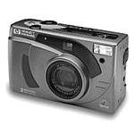
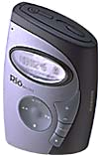



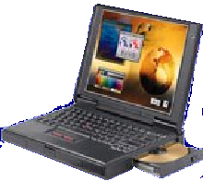


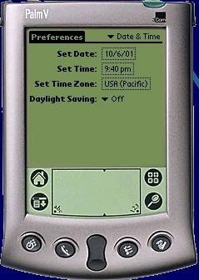
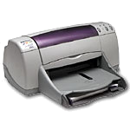
Preface
How can make devices communicate to each other more easier ?

Slide 4
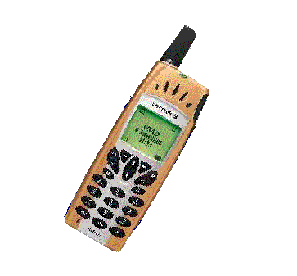
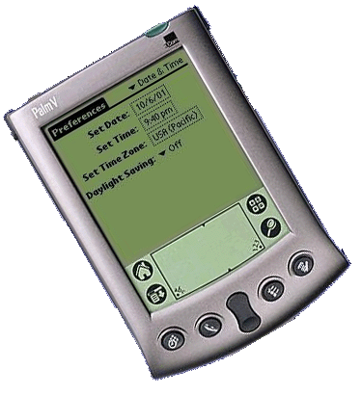



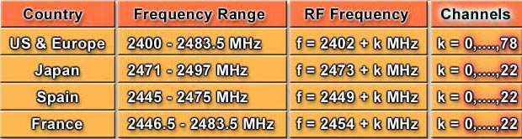
Preface
Bluetooth
TM

Slide 5
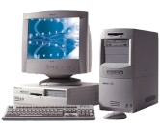
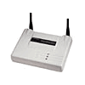
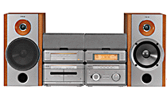

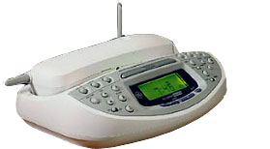
Bluetooth in PAN
Digital Camera
Computer
Scanner
Inkjet
Printer
xDSL
Access Point
Home Audio System
PDA
Cell Phone
Cordless Phone
Base Station
MP3
Player

Slide 6
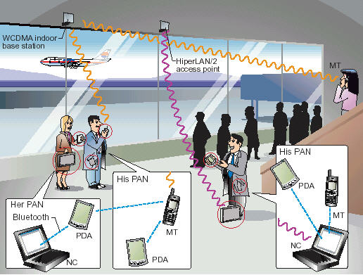
Ad-hoc Network

Slide 7
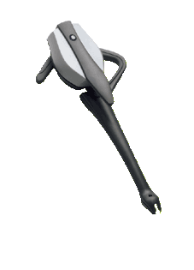

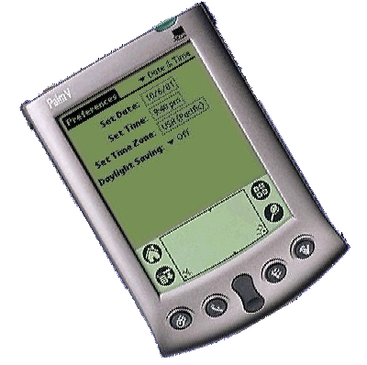
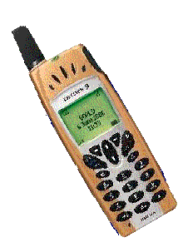

Ad-hoc Network
))))))))))))))))))))))))))))
)))))))))))))))))))

Slide 8
Objective
Develop device manager that provide facilities
in device and service discovery.
Demonstrate ad-hoc network via Bluetooth.
Study the structure of Bluetooth protocol
stack.

Slide 9
Scope
To develop device manager in ad-hoc network provide facilities in device and service discovery by implementing on Bluetooth protocol stack.

Slide 10
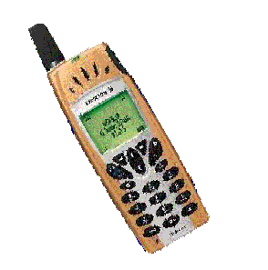
Initiate ad-hoc via Bluetooth
Find Bluetooth devices (Inquiry)
Initiate connection (Page)
Service Discovery (SDP)
Inquiry
Inquiry
Inquiry
Page
Page
Page
Service Discovery

Slide 11

Project Development

Slide 12
Process
Study Bluetooth protocol stack in each layers
Design structure of system
Define scope of device manager
Finding suitable protocol stack
Study structure and algorithm
Design software for device manager
Implementation
Testing and debugging

Slide 13
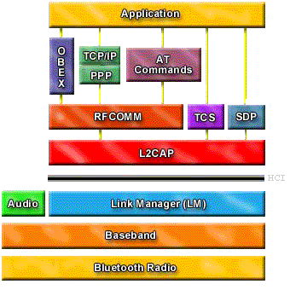
Bluetooth Protocol Stack
Software Stack
Bluetooth Host
HCI
Bluetooth Module
Hardware Stack

Slide 14
Structure of system
U
S
E
R
Application
Application
Config. App
Device Manager
Bluetooth Protocol Stack

Slide 15
Device Manager
Link Configuration Management
Device Discovery
Service Discovery
Demonstrate ad-hoc network via Bluetooth

Slide 16
Finding Protocol Stack
OpenBT
BlueZ
Bluedrekar
Cstack
OpenBT
Open Source
Provide essential layers
Use “C” in development

Slide 17
Design SW for Device Manager
Unified Modeling Language (UML)
Use case diagram
Sequence diagram
Activity diagram

Slide 18
Use Case diagram
Set scan mode
Get my information
Set bluetooth address
Set properties
Add new device
Set friendly name
Show devices & service
Find all devices
Call service
Find all devices
Find devices
Find specific devices
Chat
Find all services
Find all services
File transfer
Find services
Find specific services
Disconnect

Slide 19
Find all devices
Inquiry (2,3)
Inquiry Request
Command_status
••••
Inquiry Request
Device 1 responds
Inquiry_result (info. Device1)
Inquiry Request
Bluetooth Host
Bluetooth Module
••••
Inquiry Request
Device 2 responds
Inquiry_result (info. Device2)
Inquiry_complete (Success,2)

Slide 20
Find all services
Page
LMP_name_req
LMP_name_res
LMP_host_connection_req
LMP_host_connection_res
Local Device
Remote Device
LMP_setup_complete
LMP_setup_complete
SDP Inquires
SDP Responses

Slide 21
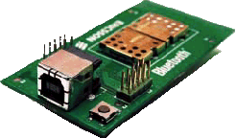
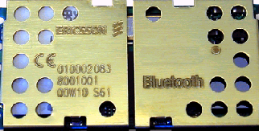
Test
Computer
Computer
)))))))))))))))))))))
)))))))))))))))))))))
)))))))))))))))))))))

Slide 22
Test process
ability in device discovery
ability in service discovery
ability in configuration
ability in using service

Slide 23
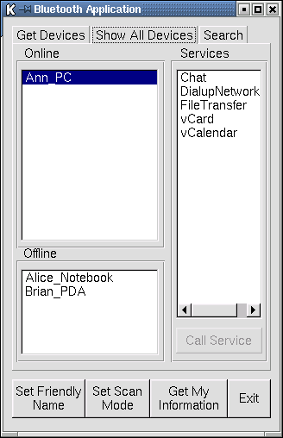
Bluetooth Application
Operation Mode
Details in each mode
Configuration

Slide 24
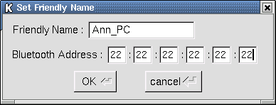
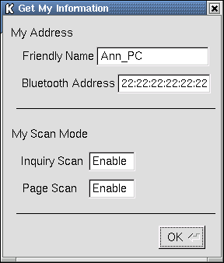
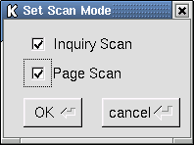
Configuration
Get my information
Set Friendly Name
Set Scan Mode

Slide 25
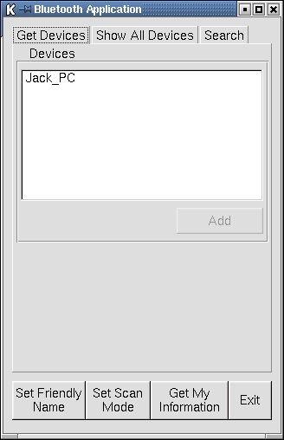
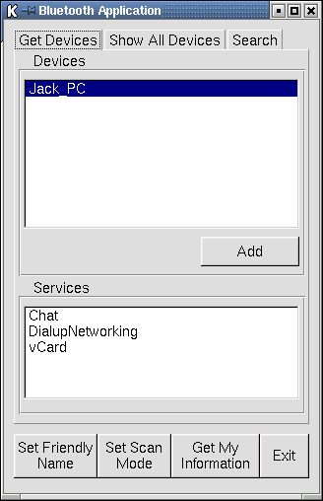
Device and service discovery

Slide 26
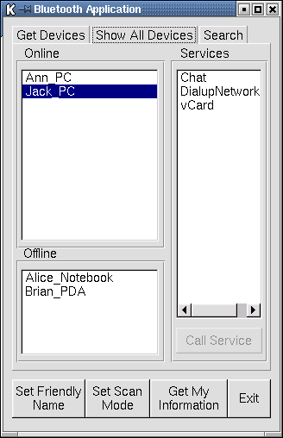
Add device to list

Slide 27
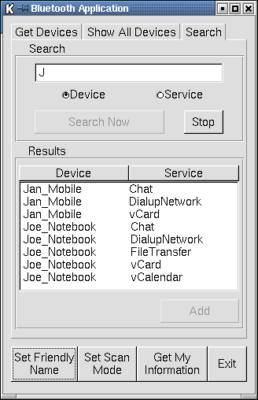
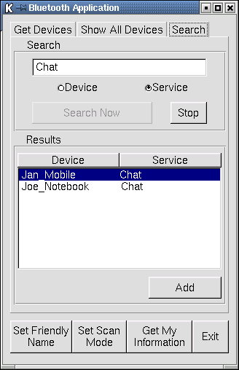
Find specific device & service

Slide 28
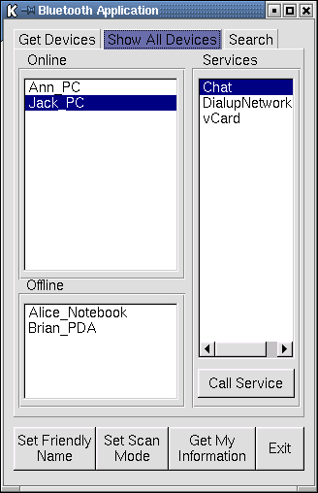
Using service

Slide 29
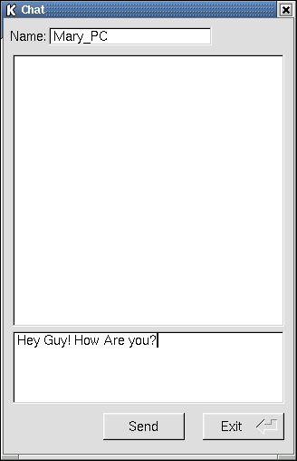
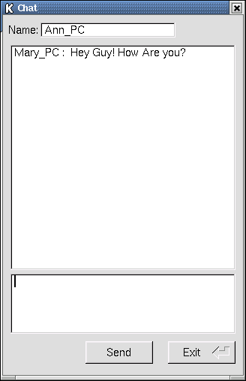
Using service

Slide 30
Conclude
ability in device discovery
ability in service discovery
ability in configuration
ability in using service

Slide 31
Problem in development
New technology
Resources
No documentation for stack
Time consume for solve the problem

Slide 32
Future Development
Development in device manager
Development in service discovery

Slide 33
Development in device manager
Link Configuration Management
Security Management
Integrating Applications
Accounting Management
Quality of Service (QOS)
User Interface Design

Slide 34
Development in service discovery
Jini
Salutation
Service Location Protocol (SLP)
Microsoft ’s Universal Plug and Play (UPnP)

Slide 35

The End
Bye-bye WIRE !!!

Slide 36
Jini
Service
Locator
Service Locator
Service Server
Client
Service
Service
Service
Registrar
Component in Jini
Service registration
Lookup Service
Service Objects
Service Attributes
Client
Service Provider
Service Objects

Slide 37
Salutation
Service
Client
Client
Service
Client
SLM-API
SLM
Salutation Manager
SLM
Salutation
Manager
Protocol
TM
TM
TM
TM
Xport
Transport
Transport
Xport
Service registry
Service discovery
Service availability
Service session management

Slide 38


Service Location Protocol
Directory Agent
Service discovery
Service registration
and update
Service
Request
Service
Registration
Service
Reply
Service Ack
User Agent
Service Agent
SLP agents and transaction
for service discovery and registration

Slide 39
Service Location Protocol
Service
Request
Service Agent
Multi-cast
Multi-cast
Multi-cast
Service Request
Service Reply
User Agent
Service Agent
Service discovery without DA

Slide 40
Finding Bluetooth devices
ID
ID
FHS
Inquiry

Slide 41
Initiate Connection
ID
ID
FHS
POLL
NULL
Page

Slide 42
Service Discovery
Baseband Paging
Procedures Set Up ACL Link
Set up L2CAP connection
Set up SDP connection
Service search attribute request
Return attributes service
Service Discovery

Slide 43
OSI Management
Configuration and Name Management
Performance Management
Security Management
Fault Management
Accounting Management

Slide 44
Bluetooth Device Management
Link Configuration Management
Security Management
Integrating Applications
Accounting Management
Quality of Service (QOS)
User Interface Design

Slide 45
Discovery test
Device Discovery
Service Discovery
find all devices
find specific device
find state of devices
in list
find all service
find specific service
find services in list

Slide 46
Configuration and service test
Configuration test
Set friendly name
Add device in list
Get device information
Set scan mode
Service test
Chat
File transfer
- Inquiry Scan
- Page Scan

Slide 47
Find all devices
Get Device Tab
Get Device
Window
PC
BT Module
User
click
click mouse event
bt_inquiry()
display this page
inquiry result(bluetooth address)
connect_req()
connect_res()
get_device_con_friendly_name()
friendly_name result
display friendly name
loop to connect

Slide 48
Find all services
Get Device Window
PC
BT Module
User
user select device
device friendly name value
service_browse_req()
service_browse_res()
display service name

